Slide 1
Hydroelectric Dam Construction
Rachel Stamps and Jackie Medina

Slide 2
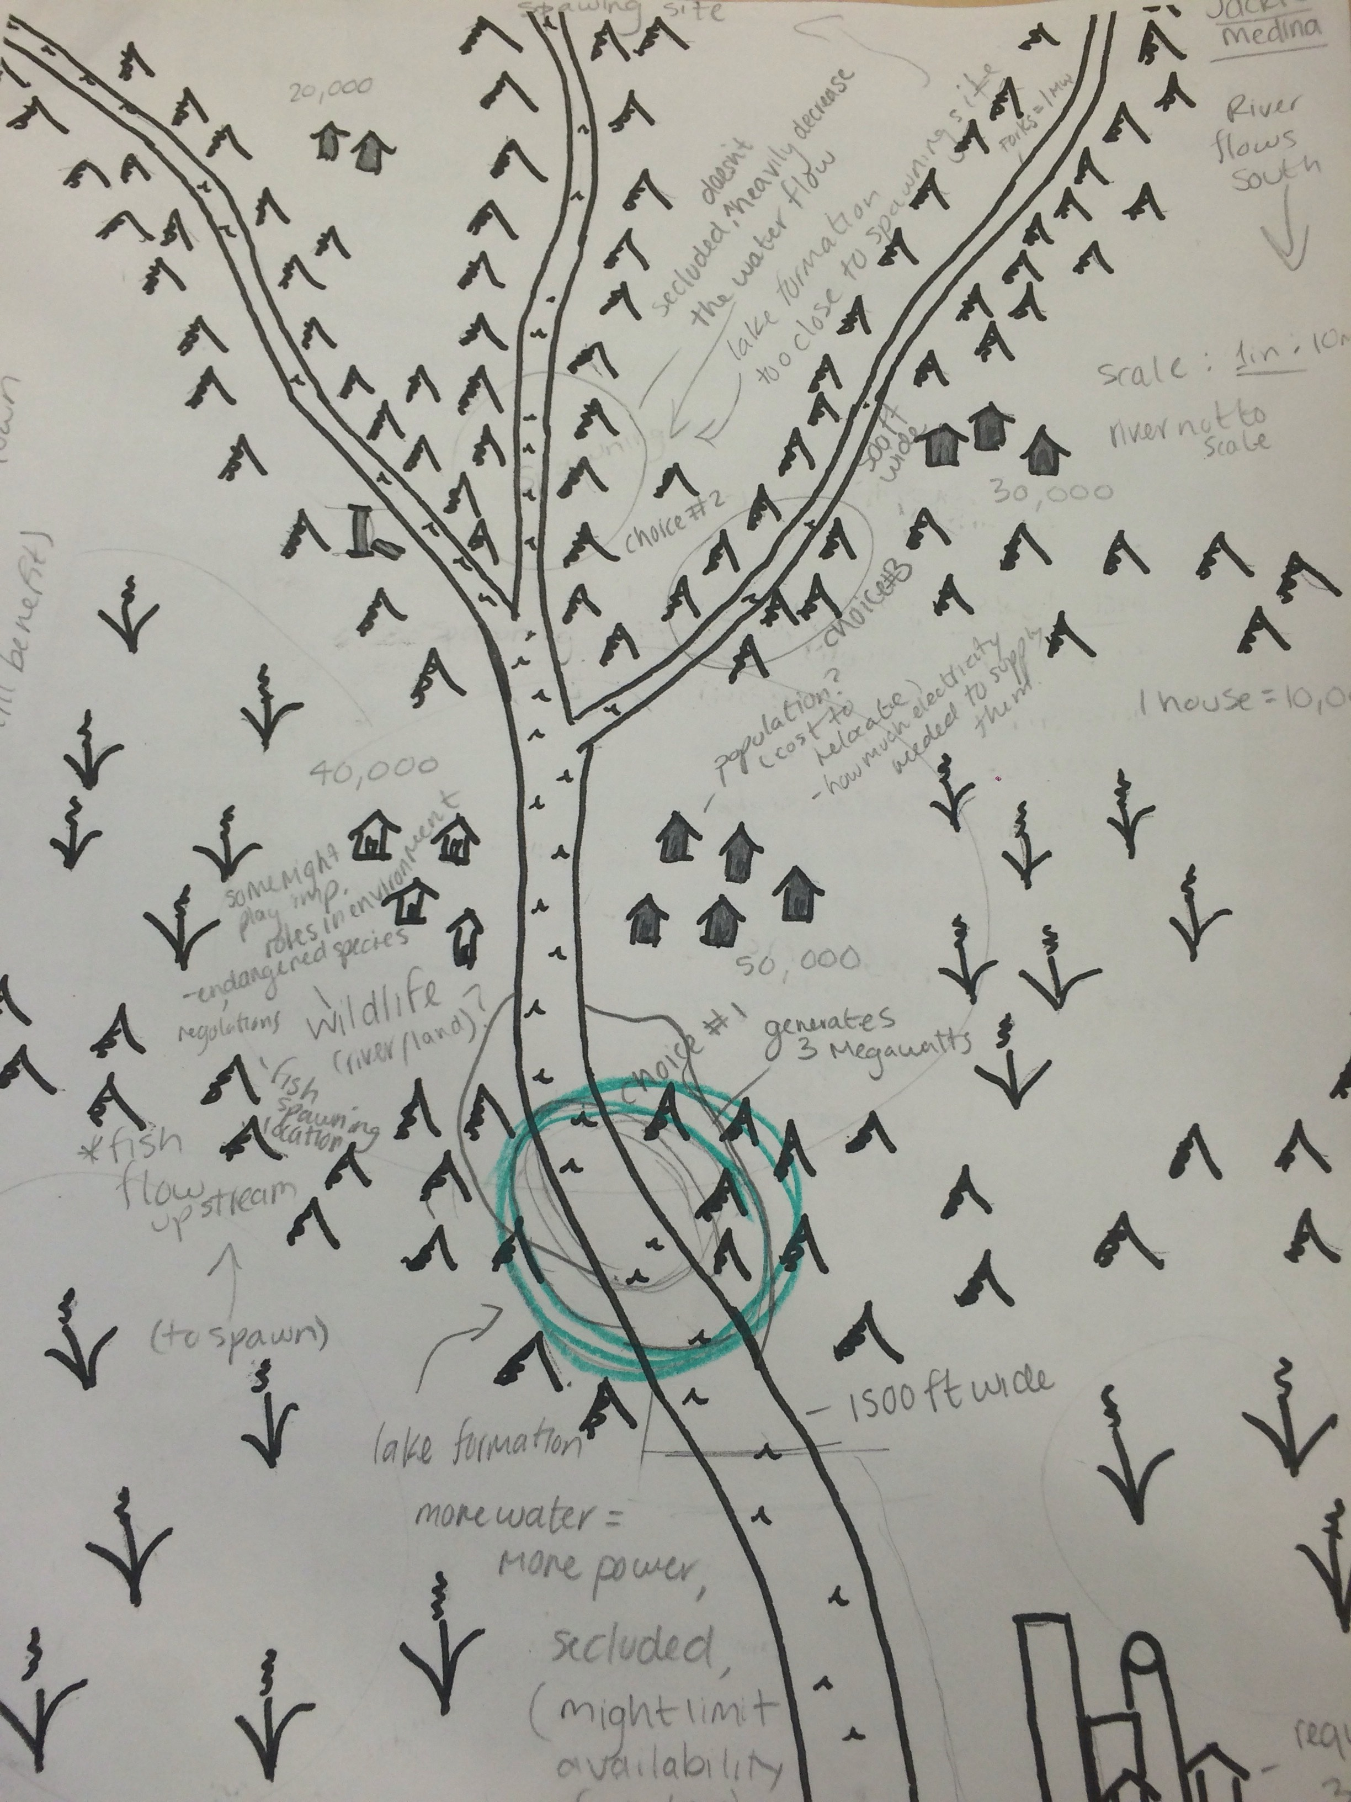
Location of the Dam
Central to populations without being too close
Near local farms
Far from spawning and historical sites
Main stream would produce more energy
.

Slide 3
How it Works
Cost about $2 billion
15 years
Fish ladders for fish spawning migration (at first thought to do streams)
Screen in front of turbines
High wall in case of flooding

